Slide 1
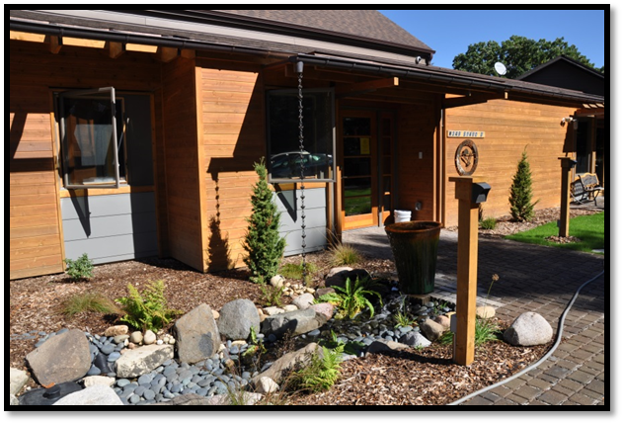
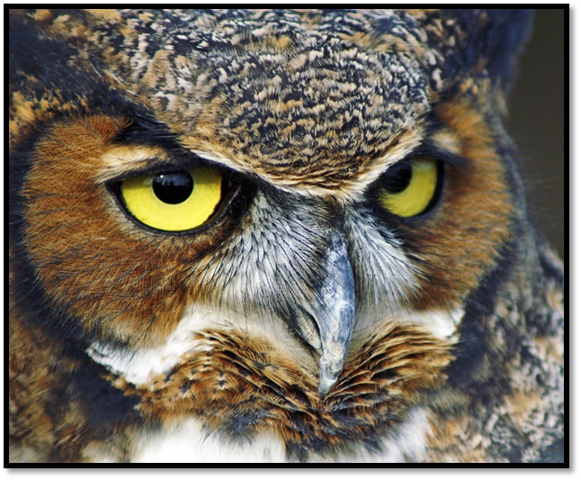

Wildlife In Need Center
Annual Report 2014
Connecting people and wildlife through education and rehabilitation since 1994
www.helpingwildlife.org

Slide 2
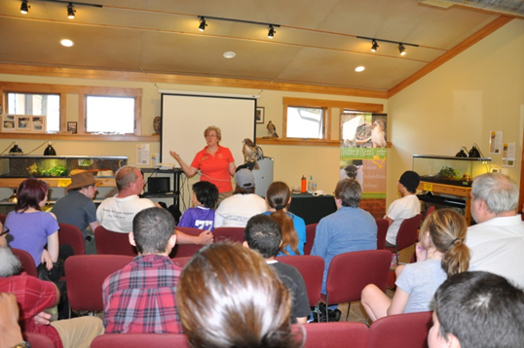
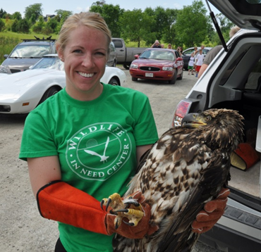
Wildlife In Need Center (WINC)
Mission and Vision Statement
Education programs in
WINC’s gathering room
Wildlife Rehabilitation
and Release
MISSION STATEMENT
To provide wildlife rehabilitation to Wisconsin wildlife with the intent to release back to their native habitat, conduct research designed to further the positive impact of rehabilitation, and provide quality community education programs and services.
VISION STATEMENT
To become a nationally recognized Wildlife Rehabilitation Center that serves as a hub for other satellite facilities and is financially stable. WINC will work in collaboration with the University of Wisconsin-Waukesha and the University of Wisconsin Colleges and Extensions to be identified as the number one resource in the community that promotes an ethic of care and respect for the natural world.
WINC Mission supporter: I became involved with WINC after attending a fund raising dinner two years ago. I was so impressed with the mission of the program and the enthusiasm and passion of the staff, I wanted to do more. I became involved in the fund raising process and introduced friends and family to the center. My niece was so interested and enthusiastic we purchased a membership for her and she is now a volunteer at the center. Our Niece is now contemplating a career as a veterinarian…Sandy Harsh

Slide 3
A message from WINC Board President
In 2014, the Wildlife in Need Center (WINC) has continued its efforts to be one of the most professional wildlife rehabilitation centers in Wisconsin. We are one of two wildlife rehabilitation facilities in Southeastern Wisconsin that admit most species of Wisconsin wildlife. Our educational program sets us apart from any wildlife rehabilitation facility in Southeastern Wisconsin.
Since 1994, WINC’s essential mission has been increasingly heard, requiring it to expand from a small one-bedroom house. On June 27, 2011 WINC opened a greener, public-friendly and spacious 6,000-square foot facility. Our new facility offers increased service and additional capacity to accommodate our wildlife patients. Larger facilities enable WINC to offer more education, including on-site programs and displays, research and, of course, up-to-date medical care treatment. 2014, WINC entered its fourth year in the partnership with University of Wisconsin-Waukesha on their 92 acre property.
In 2014, to meet the demand for wildlife rehabilitation, WINC added two seasonal qualified staff in animal care. Our year round staff now consists of two full- time office staff, a part-time bookkeeper, one part-time education coordinator, two full-time and one part-time animal care staff. In addition our volunteer program continues to grow as we add and train new volunteers monthly, while maintaining a very high retention rate. The collaboration, hard work, and dedication of our staff and volunteers to provide excellent care to wildlife is truly commendable.
Two very qualified veterinarians whom charge WINC a reduced rate, have helped expand WINC’s scope and care. We strive to improve and impact our care and patients each day.
With our staff and volunteers committed to our cause, securing sound financial footing enables us to provide the best possible care for our patients – and the future of WINC. Join me as we look to begin a new year in the WINC long and distinguished history.
Sincerely,
Holly Schlenvogt
WINC Board President

Slide 4
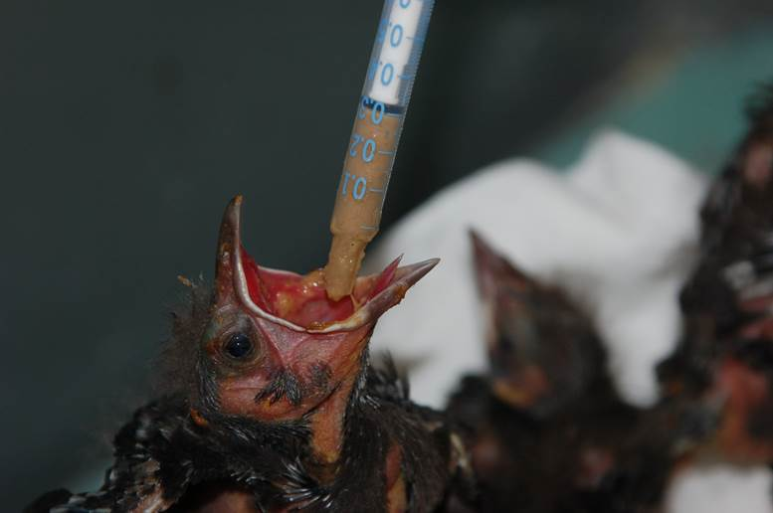
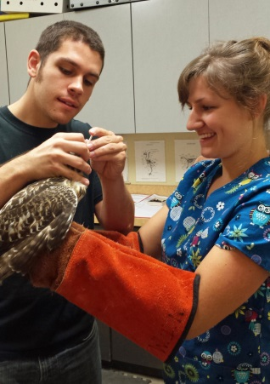
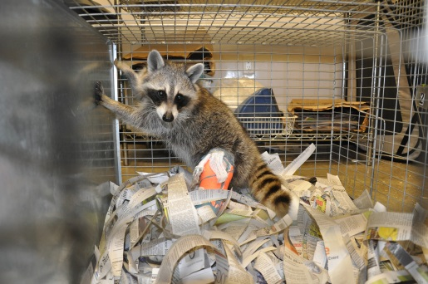
2014 in Review
Animal Care
Admitted and cared for over 2,581 sick, injured or orphaned wildlife
Fielded over 10,000 phone calls to assist our communities with questions regarding Wisconsin wildlife
Provided hands-on experience to 10 college interns who seek employment in a wildlife related field
Entered our 14th year of Baby Bird feeding program utilizing 12 year old and older volunteers
Continued implementation of an updated in house drug formulary to provide appropriate medicine dosing for all species
Baby Bird Feeders
Interns and rehabilitating a raccoon
Development
Started gathering data in preparation our three-year strategic plan to guide the organization
Held an inaugural “Dakota Society” event to develop a planned-giving program
Held an annual pancake breakfast, banquet and Fine Wine and Dine fundraising events
Increased Facebook following by 70% and posting nearly every day
Transformed WINC’s outdoor environment by planting native plants to feed and provide nesting sites for Wisconsin wildlife

Slide 5
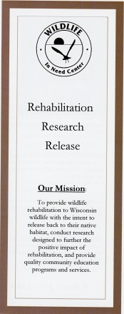
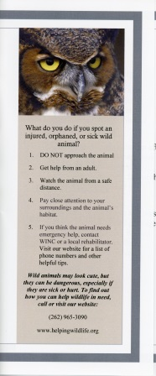
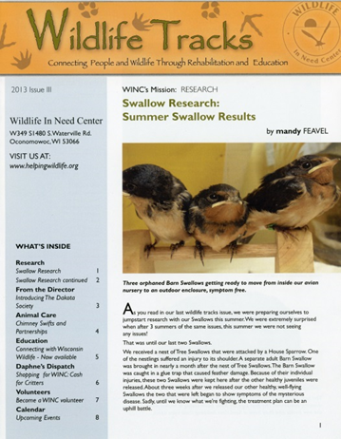
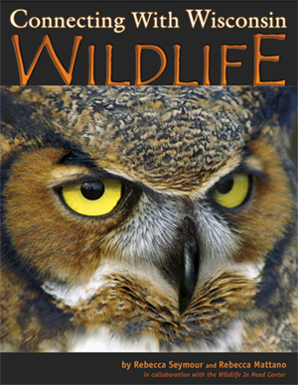
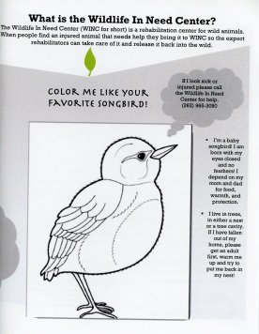
Education
Presented 117 education programs with the assistance of our 16 Animal Ambassadors
Awarded Creative Child Magazine’s, “2014 Preferred Choice Award” for WINC's book on Wisconsin's environment - Connecting with Wisconsin Wildlife
Animal Care Manager presented at National Wildlife Rehabilitators Association Symposium in March 2014 about Dakota
Introduced to the public three new animal ambassadors: a barred owl, a screech owl, and a captive bred bull-snake which is a protected species in Wisconsin
Presented "Call Before You Kidnap" public awareness program that informs the community about the best way to interact with baby mammals who appear to be orphaned but are not
Held three Meet and Greet sessions at WINC to educate the public about Wisconsin Wildlife
Utilized three new environmental educational brochures

Slide 6

2014 Highlights
Since its inception over 45,000 animals have been treated at WINC
Over 80% of our patients are admitted due to purposeful or accidental human interaction
Through good stewardship, 63% of every dollar raised goes toward animal care and our education program
WINC carries no bank debt nor does our organization have a mortgage
WINC receives no government or state funding, and funds the organization through fundraising efforts and through the generosity of its passionate supporters
 | 2014 | 2013
Budget | $314,678 | $348,931
Assets | $1,003,121 | $1,025,133
Donor restricted funds | $8,600 | $18,065
Volunteer and In Kind Donations | $170,000 | $160,000
Education Program: The Wildlife In Need Center was a heartwarming experience for our residents who were actively engaged in treatment here in our specialized clinical program. Seeing vulnerable animals cared for with such kindness, in the process of rehabilitation, was a powerful metaphor that each child could easily relate to. The visit clearly helped motivate our teens to show more compassion, and to give and receive assistance to each other with more empathy. The experience had a positive impact and motivated them to continue progressing in their battles with depression, trauma, and other challenges. We look forward to visiting again periodically through the year. We feel fortunate to have you close by and are excited to support your outstanding mission. Mark Germano Rogers Memorial Hospital or anonomouys??

Slide 7
Financials
Income | 2014 | 2013
Membership | $ 73,531 | $ 69,654
Individual/Estate Gifts | $ - | $ 111,632
Corporate /Foundation | $ 47,652 | $ 45,653
Donations
Fundraisers | $ 202,007 | $ 135,310
Education | $ 12,033 | $ 9,480
Other | $ 4,476 | $ 6,325
Donor Restricted | $ - | $ -
Totals | $ 339,698 | $ 378,053
Expenses | 2014 | 2013
Animal Care | $ 186,015 | $ 194,960
Education | $ 37,412 | $ 39,766
Development | $ 33,418 | $ 27,010
General and Administration | $ 102,091 | $ 113,000
Fundraisers
Other | $ 4,129 | $ 1,532
Totals | $ 363,066 | $ 376,267

Slide 8
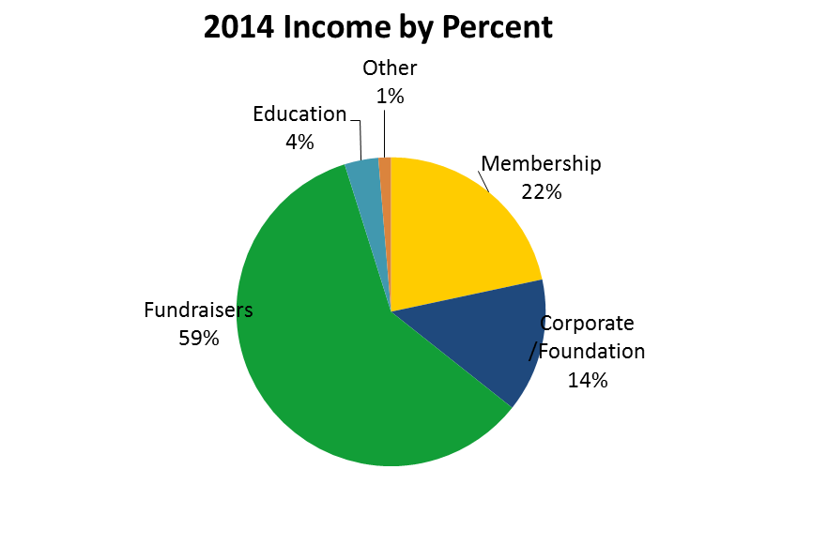
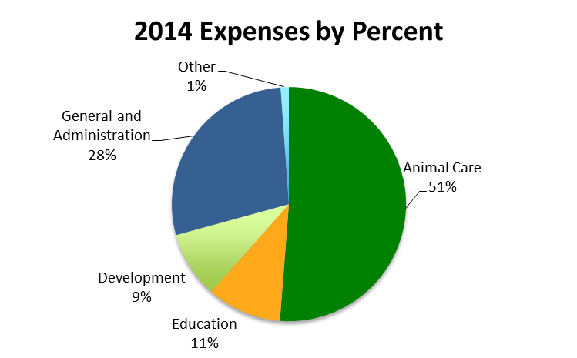
2014 Financial Highlights

Slide 9

Activity Counts
 | 2014 | 2013
Number of Animals admitted | 2581 | 2777
Total Patient Days | 46,006 | 46,225
Education Programs People Reached | 117 25,664 | 141 27,539
Volunteer Hours Tracked | 15,126 | 15,904
Facebook Followers Popular Story hits People reached weekly | 3,400 12,000 6-8,000 | 2,000 4,000
Phone calls wildlife consultation | Over 10,000 | Over 10,000
WINC Volunteer: Being a WINC volunteer these past 14 years has given me the opportunity to care for and see up close the beauty of our native wildlife as well as learn their natural history. With this knowledge I have been able to help others appreciate the wildlife in their backyards. You really learn to see nature in a whole new perspective when it becomes as personal as it does at WINC. Nothing compares to the joy of releasing a rehabilitated animal back to it's native habitat….Nancy Meier

Slide 10
Wildlife In Need Center making a difference!
Education Program: In October we attended a Raptor Education Program at WINC. Both of us were so impressed with your educator, Leslie Kiehl. She has such rapport with the raptors and they respond to her with comfort and understanding. She is a great representative for the Center. We also applaud your mission to help people in Waukesha County understand the importance of wildlife in our lives. Not only do birds and animals add joy for us, they are a significant part of our ecosystem. Thank you for all the work your organization does to make Waukesha a better home for all it citizens, including our wildlife. We are fortunate to have your agency in Waukesha County…Emily and George Lorenz
Education Program: Wonderful experience for old and young alike. Professionally executed by knowledgeable WINC staff. It was a great gift from friend to friend….Rosemarie and Dean Buntrock
Phone Consultation: I do want to thank your staff for taking the time to help us with the baby bats that we were finding all over our indoor arena. It started out to be so challenging trying to find anyone with the expertise on helping these bats who seemed to have lost their way. It was great to talk to someone with the patience and understanding of these misunderstood mammals. Sadly they are now endangered and need our voices more then ever….Jody Riesberg
WINC Mission Supporter: Mary and I did rehab and foster care out of our home for fifteen years. We realized that the long term answer for helping the animals is a Center like WINC with dedicated Staff and Volunteers to do this task 24/7…Tom and Mary Roberts
Animal Care: Testimony on an injured Red-Tailed Hawk…After calling WINC, I was told to bring her right in. The relief I felt knowing someone was there to help.. When I drove up....Within seconds Mandy came running out with her big gloves and carrier. The wing was so damaged I thought it was over. The fantastic vet that did the surgery and put back together this wonderful animal was a miracle worker. The amount of time and sacrifice they gave was amazing. I was invited to her release and it brought tears to my eyes to see what had been this broken beauty restored to her former amazing self….Pat Turner
Education Program: The education program that we had at the Waukesha school where I teach was wonderful. It exposed our students, who live in the city, to animals that most of them have never seen or heard about before. The little ones were especially interested in the turtles and made pictures and wrote about them. Our older students were fascinated about animal rehabilitation and why the animals come to the wildlife center. They were particularly interested in imprinting. We read books about wildlife rehabilitation. The knowledge they gained from the WINC presentation gave our students so much information and knowledge that they hadn't had before. Mandy and Angela did an excellent job. Thank you so much for coming out into the community and providing this knowledge!... Lynn Rice

Slide 11

Board of Directors 2014
Holly Schlenvogt
President
John Rodell
Past President
Wayne Grandy
Vice President
Michael Guzniczak
Treasurer
Kim Banach
Secretary
Tom Gilligan, DVM
Jean McFadden
Harry Muir, PhD
Dean Pipito
Tom Roberts, MD
Lynn Wilde
Noah Zimmerman, PhD
WINC Staff 2014
Lisa Rowe
Director of Operations
Danielle Fleischman
Development Assistant
Mandy Feavel
Animal Care Manager
Chelsea Shapiro
Assistant Animal Care Manager
Jen Brei
Animal Care Staff
Seasonal Animal Care Staff
Leslie Kiehl
Education Coordinator
Bookkeeper

Slide 12
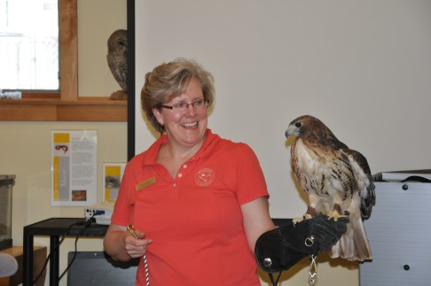
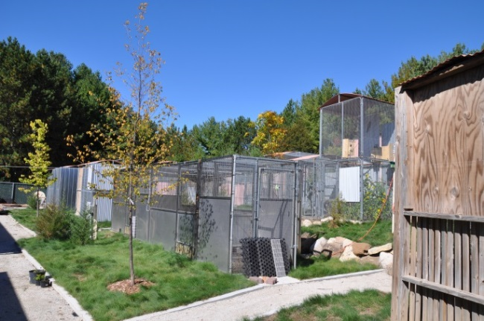
Wildlife In Need Center still needs your help
Become a member
Cash donations
Foundation grants
Memorials
Bequests
Matching employee gifts
Follow us on Facebook for daily posts and unique requests
Volunteer and make a difference
Volunteer in the office, animal care, baby bird feeding, rescue and transport, wildlife release site, fundraising, and maintenance.
Wish list donations - refer to our website
Attend WINC’s fundraising events
March 29, 2015 Pancake Breakfast
April 24, 2015 Annual Banquet
October 30, Fine Wine and Dine
Outdoor Animal Care Enclosures
Education Program with Leslie Kiehl and Raenah, the Red Tailed Hawk

Slide 13
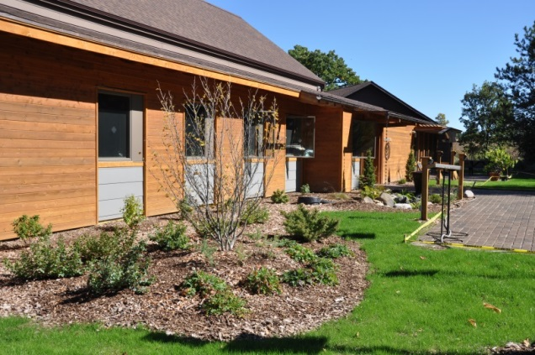
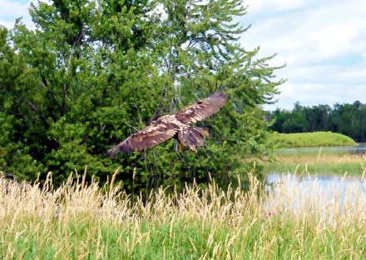
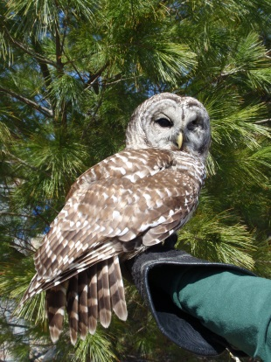
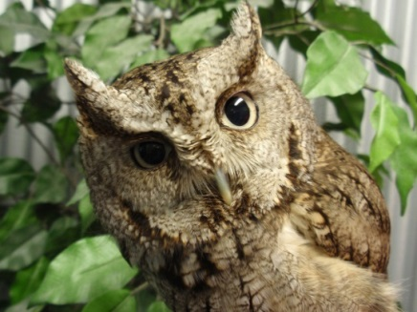
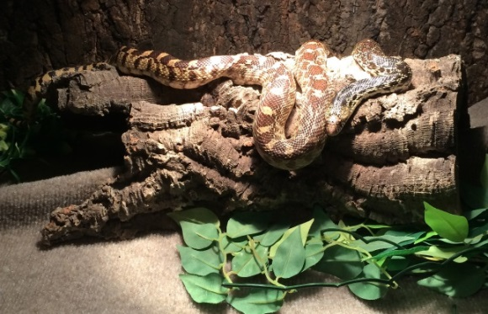
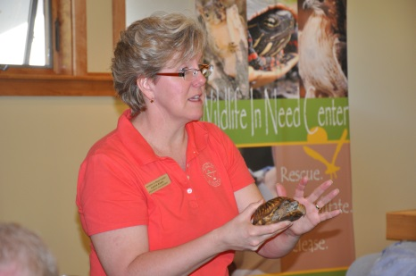
Wildlife In Need Center
Annual Report 2014
Landscaping feeding wildlife
American Bald Eagle Release
Debut of three new Educational Ambassadors
Education programs
W349 S1480 S. Waterville Rd
Oconomowoc, Wisconsin 53066
(262) 965-3090
www.facebook.com/pages/Wildlife-In-Need-Center/122166414520750
www.helpingwildlife.org

